Slide 1



Monadic parser combinators in C#
Speaker: Alexey Golub
@Tyrrrz

Slide 2

name: Alexey Golub
primary_occupation: Open Source Developer
pays_the_bills:
position: Senior Software Developer
company: Svitla Systems
tech_stack:
- C#
- .NET Core
- Azure/AWS
links:
- https://github.com/tyrrrz
- https://twitter.com/tyrrrz
- https://tyrrrz.me
Speaker: Alexey Golub
@Tyrrrz

Slide 3
Agenda
What is a parser and what does it do?
Formal theory of language and grammar
Structural representation of context-free grammars
Different ways to build a parser
The concept of “parser combinators”
Live-coding session (writing a JSON parser)
Speaker: Alexey Golub
@Tyrrrz

Slide 4
What is a parser?
What we see:
What computer sees:
“123 456,93”
byte[10] { 49, 50, 51, 32, 52, 53, 54, 44, 57, 51 }
What we understand:
What we want computer to understand:
thousands separator
new SyntacticComponents[] {
new NumericLiteral(123),
new ThousandsSeparator(),
new NumericLiteral(456),
new DecimalSeparator(),
new NumericLiteral(93)
}
123 456,93
numeric literals
numeric literal
decimal separator
Speaker: Alexey Golub
@Tyrrrz

Slide 5
What does a parser do?
Input
“<foo><bar/></foo>”
“<foo></bar>”
“hello world”
Domain objects
new XElement(“foo”) {
new XElement(“bar”)
}
success
Rejected invalid input
Unexpected token “</bar>” expected “</foo>”
Unexpected token “hello world”
Parser
grammar + context
fail
Speaker: Alexey Golub
@Tyrrrz

Slide 6
What are parsers used for?
Data deserialization (JSON, XML, YAML)
Static code analysis (ReSharper, TSLint)
Syntax highlighting (VS Code, Highlight.js)
Compilers, transpilers, interpreters (Roslyn, Markdig, Babel, SQL)
Template engines (Razor, Liquid, Scriban)
Natural language processing (Spellchecking, Translation)
Speaker: Alexey Golub
@Tyrrrz

Slide 7
Formal language theory
Alphabet
set of allowed characters
Grammar
set of rules that define how words are generated
Words
set of valid combinations of characters or other words
Language
Speaker: Alexey Golub
@Tyrrrz

Slide 8
Formal grammar
Regular grammar
A → a, where A is non-terminal and a is terminal
A → aB, where A and B are non-terminals and a is terminal
Context-free grammar
A → ⍺, where A is non-terminal and ⍺ is a string of terminals and/or non-terminals
Speaker: Alexey Golub
@Tyrrrz

Slide 9
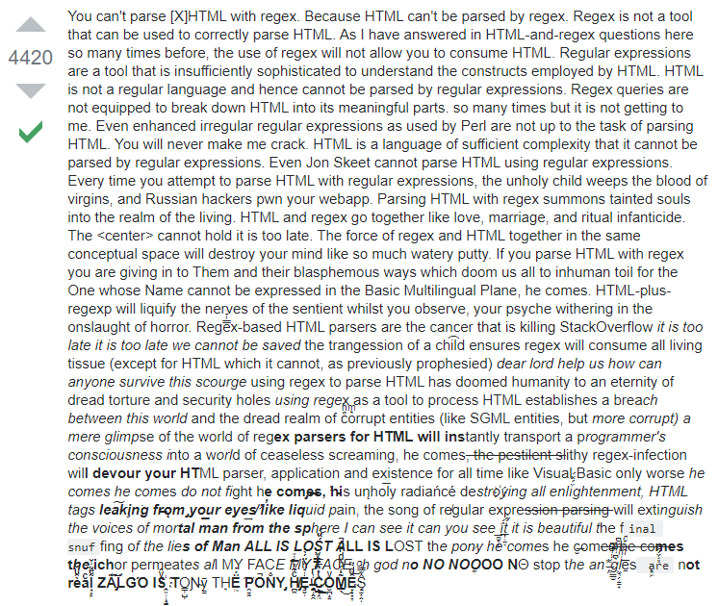

Slide 10
Rule of thumb
Context-free
yes
Contains recursive grammar
no
Regular
Speaker: Alexey Golub
@Tyrrrz

Slide 11
Syntax trees
Context-free languages are structurally represented using syntax trees
Syntax trees are used to make sense of the input text
Root
Non-terminal node
Terminal node
Terminal node
Terminal node
Speaker: Alexey Golub
@Tyrrrz

Slide 12
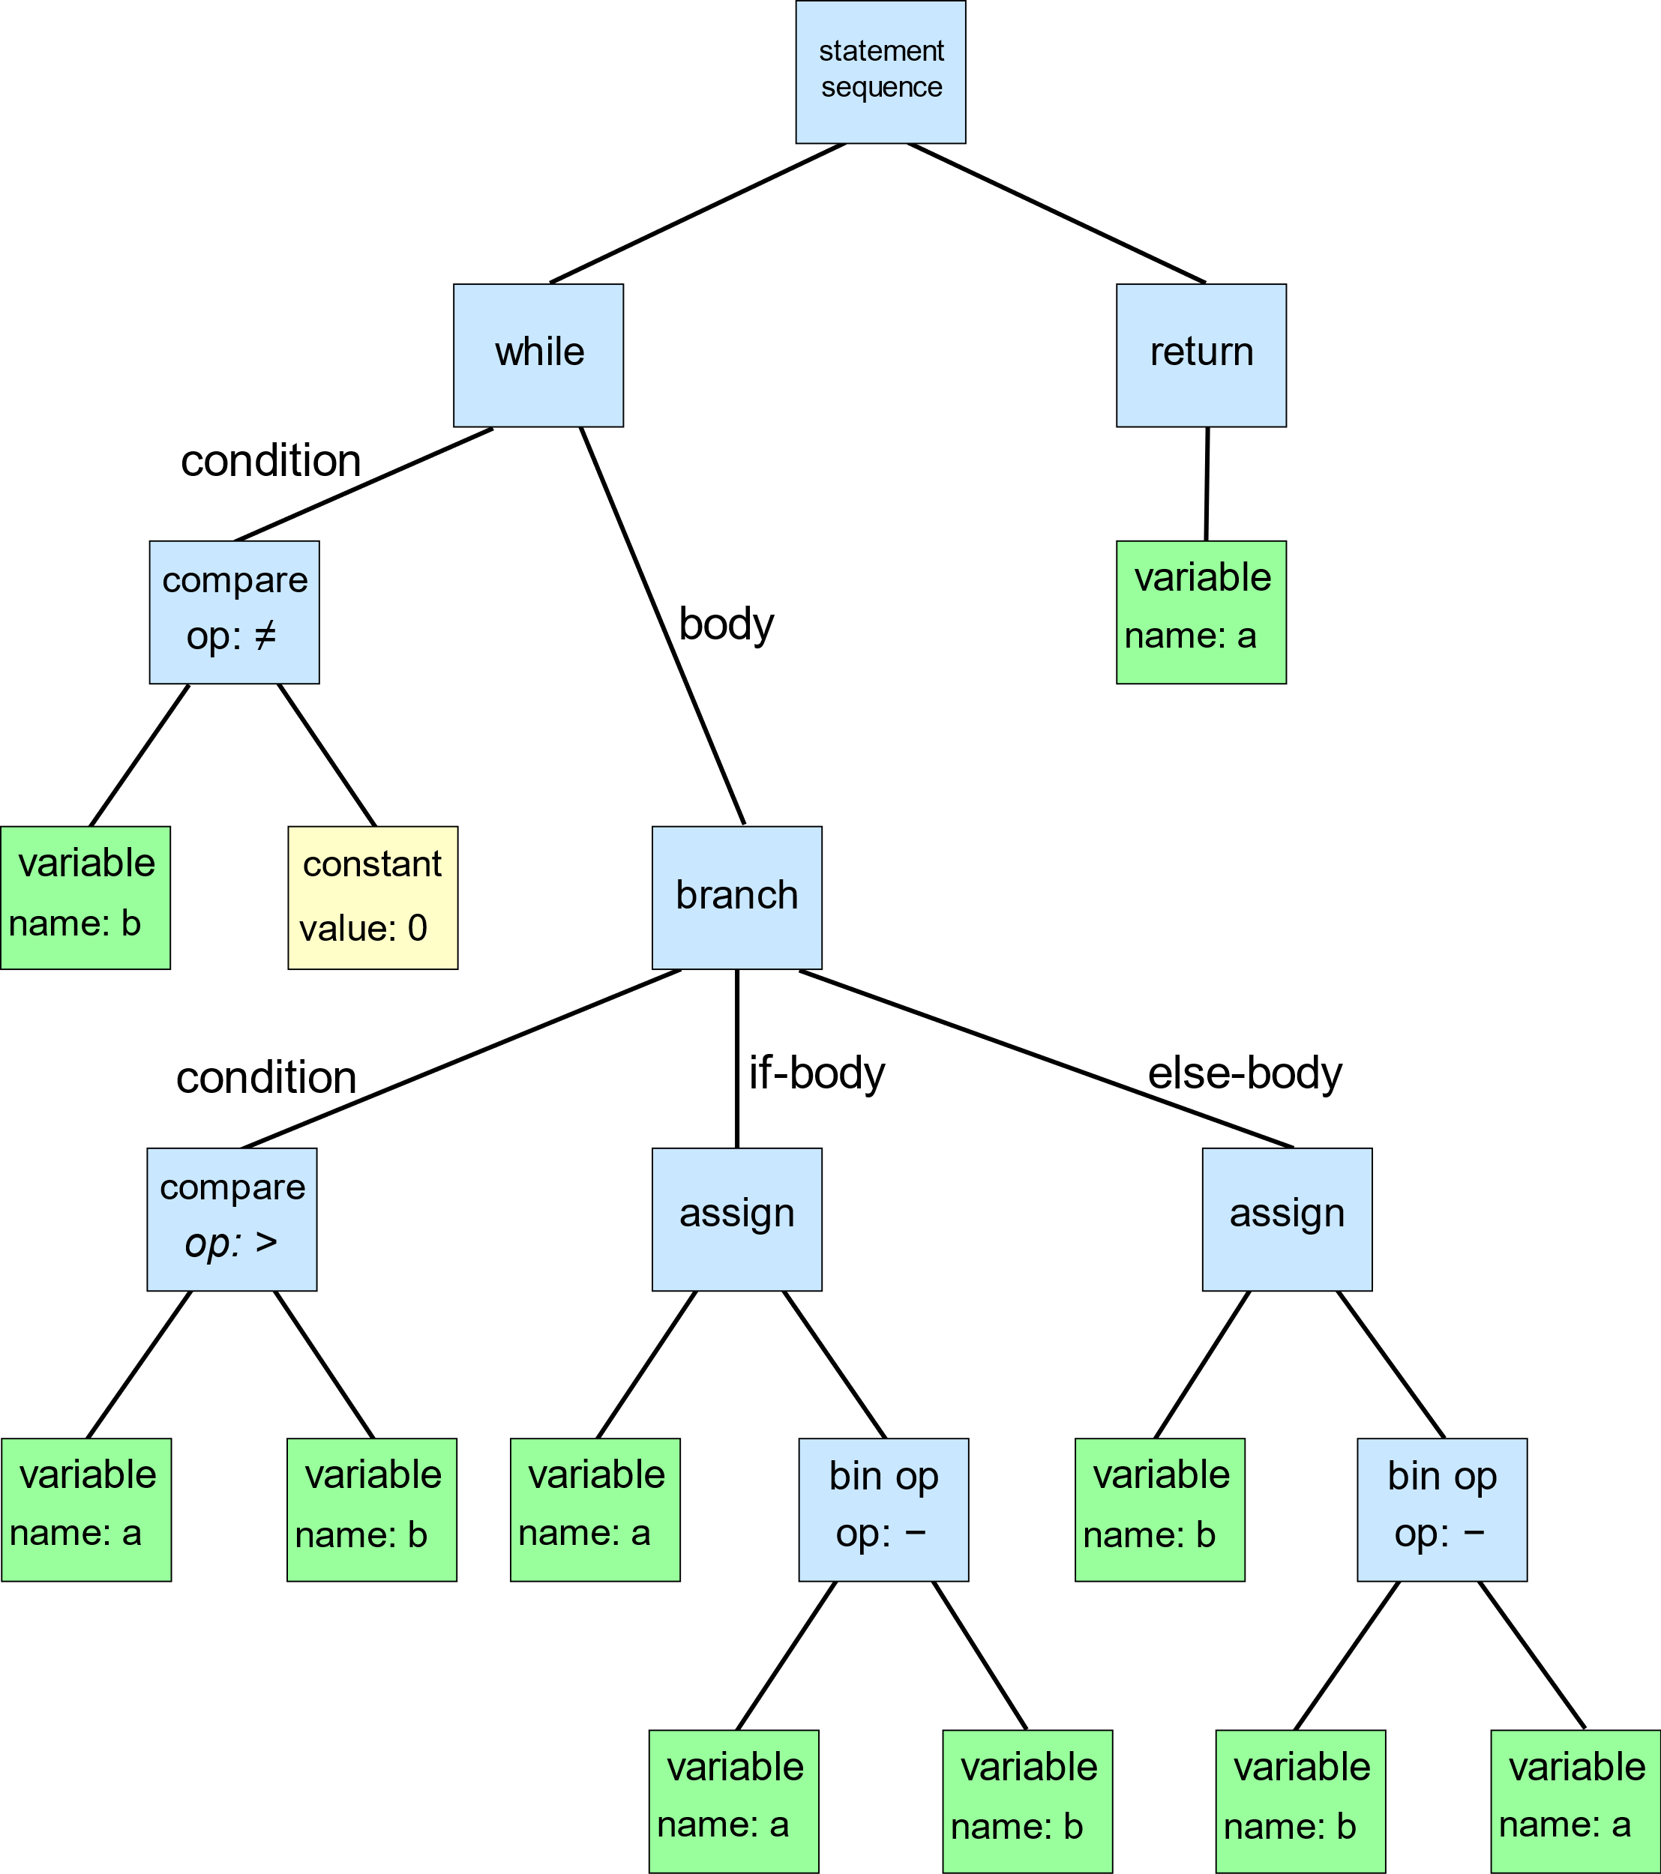
Example AST produced by C-like code
while (a != 0)
{
if (a > b)
{
a = a - b;
}
else
{
b = b - a;
}
}
return a;
Speaker: Alexey Golub
@Tyrrrz

Slide 13
Loop/stack-based manual parsers
Loop through all characters in the input
Maintain context on a stack
Pros:
Performance
Fine-tuning
Debugging
Cons:
Hard to write/read/maintain
Code is not expressive
Speaker: Alexey Golub
@Tyrrrz

Slide 14
Parser generators
Define grammar in a specialized language
Generate consuming code in one of the supported languages
Pros:
Expressive
Language-agnostic
Cons:
Overhead of an extra language
Can’t leverage the power of C# to write grammar
Speaker: Alexey Golub
@Tyrrrz

Slide 15
Parser combinators
Define grammar using higher-order functions
Build complex parsers by combining simpler ones
Pros:
Expressive
Easy to write/read/maintain
Everything is in C#
Cons:
Performance
Debugging
Speaker: Alexey Golub
@Tyrrrz

Slide 16
Parsers vs combinators
Parser<T>:
(success, result, length) = f(input, offset=0)
Examples: Char('a'), String("foo"), Digit
Combinator<T>:
Parser<T> = f(parser1, parser2)
Examples: Or(p1, p2), Many(p), DelimitedBy(p1, p2)
Speaker: Alexey Golub
@Tyrrrz

Slide 17
Parser combinators illustrated
Input: 10 + 5
Parser:
Number:
AtLeastOne(Digit)
THEN
Sign:
Many(WhiteSpace)
Or(‘+’, ‘-’, ‘*’, ‘/’)
Many(WhiteSpace)
THEN
Number:
AtLeastOne(Digit)
-> “10”
-> ‘1’, ‘0’
-> “ + “
-> “ “
-> ‘+’
-> “ “
-> “5”
-> ‘5’
PlusOperator
Number (10)
Number (5)
Speaker: Alexey Golub
@Tyrrrz

Slide 18
Live-coding time
Let’s develop a basic JSON parser using Sprache in C#
Speaker: Alexey Golub
@Tyrrrz

Slide 19
Links
JSON parser from earlier – https://github.com/Tyrrrz/DotNetFest2019
Sprache – https://github.com/sprache/Sprache
Parsing in C# by Federico Tomassetti – https://tomassetti.me/parsing-in-csharp
Formal grammar on Wikipedia – https://en.wikipedia.org/wiki/Formal_grammar
Other .NET parser-combinator libraries:
Superpower (C#), Pidgin (C#), FParsec (F#)
Speaker: Alexey Golub
@Tyrrrz

Slide 20
Thank you!
Speaker: Alexey Golub
@Tyrrrz

